Slide 1
PROFILE BASED ROOM AUTOMATION USING AI
GROUP NO :- 5
MEMBERS:- ANIRUDDH PATIL NAMRATA JOSHI GARGI SURVE
GUIDE : -
PROF. APEKSHA MOHITE
CO-GUIDE:-
PROF. NAHIDKAUSAR SHAIKH

Slide 2
INTRODUCTION
▶ WHY
▶ To provide control over one’s environment
▶ To ease and improve living experience
▶ WHAT
▶ Automated Room Control System
▶ Intelligent User Based Profiling
▶ HOW
▶ Use of Android Things to control the IOT Experience
▶ Use of Tensorflow for Machine Learning

Slide 3
ABSTRACT
▶ The objective of the proposed idea is to explore the ever expanding world of IoT.
▶ IoT involves extending internet connectivity beyond standard devices, to a range of non-internet enabled physical devices like lights and fans.
▶ System facilitates integration of data analytics and pattern recognition based on certain algorithms.
▶ The system adapts to the user patterns using machine learning with the help of TensorFlow.
▶ Following is a system which allows the user to control their environment over the internet learning the patterns and maintaining the profiles for every user.

Slide 4
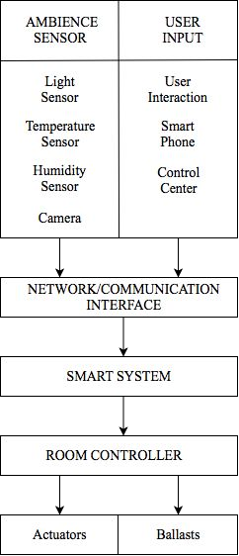
PROPOSED SYSTEM
▶ User Profiles
▶ Room Control
▶ Smart Learning
▶ Decision Making Based on patterns learned
▶ Remote Handling
▶ Motion Based Decision Making

Slide 5
TECHNOLOGY STACK
▶ Sensor Data Collection - Arduino
▶ Commands Relaying - Arduino
▶ Actuation - Node MCU
▶ Database – Firebase
▶ Machine Learning Tool – Tensorflow
▶ Model Training – Keras
▶ IOT Enablement – Android Things
▶ Remote Controlling – Android App
▶ Image Recognition – Google Vision

Slide 6
PROJECT PLANNING
▶ Phase 1: Planning(1 week)
▶ Information gathering – literature base ,reviewing research papers
▶ Learning new technology
▶ Phase 2: Defining(1 week)
▶ Documentation
▶ SRS
▶ Phase 3: Designing(2 week)
▶ Preparation of DFDS

Slide 7
PROJECT PLANNING
▶ Phase 4: Building(4 months)
▶ Prototype building
▶ coding
▶ Phase 5:Testing (1 month)
▶ Training and testing sets for the model
▶ Phase 6: Maintenance and Deployment

